Slide 1

Support Vector Machine (SVM)
Theory, Mathematics, Hyperparameters & Real-World Applications
Prepared by: Vivek Kumar | Course: Machine Learning

Slide 2
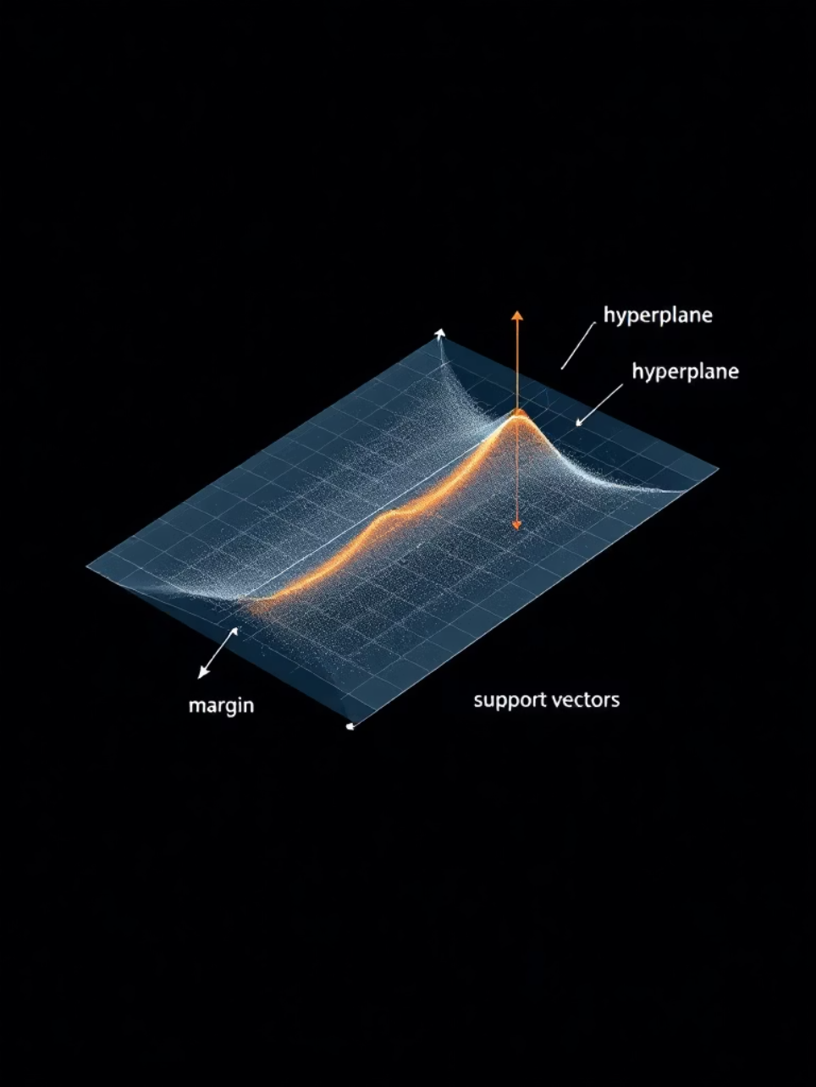
What is a Support Vector Machine?
A Support Vector Machine is a supervised machine learning algorithm used for classification and regression tasks. At its heart, SVM is a maximum margin classifier that seeks the optimal hyperplane to separate different classes with the greatest possible margin.
The key concept revolves around identifying the optimal hyperplane that maximises the distance between the nearest data points of different classes—these critical points are called support vectors.
Support Vectors
Margin
Hyperplane
Data points closest to the decision boundary that influence the hyperplane's position and orientation
The distance between the decision boundary and the nearest data points from each class
The decision boundary that separates different classes in the feature space

Slide 3

Why Do We Need SVM?
Understanding the limitations of alternative approaches reveals SVM's unique value proposition.
Overcoming Logistic Regression Limits
Whilst logistic regression can handle linear relationships, it struggles with non-linear boundaries and lacks robustness in high-dimensional spaces. SVM's margin maximisation provides better generalisation.
Handling Non-Linear Separability
Through the kernel trick, SVM can transform non-linear problems into linearly separable ones without explicit dimension transformation—something traditional methods cannot achieve efficiently.
Robustness to Overfitting
Structural Risk Minimisation principle ensures SVM balances model complexity with training accuracy, reducing overfitting risk compared to KNN and other instance-based learners.

Slide 4

How SVM Works: Mathematical Foundation
Understanding SVM requires appreciating its elegant mathematical formulation.
The Optimization Problem
Key Mathematical Concepts
SVM constructs a hyperplane by solving a convex optimization problem. For linearly separable data, the objective is:
Margin Width: \frac{2}{||w||} — the distance between classes
Support Vectors: Points where equality holds in constraints
Convex Optimization: Guarantees finding the global optimum
Duality: Enables efficient solution through Lagrange multipliers
Where w represents weights, b is the bias term, and the constraint ensures correct classification.
Margin Maximisation
Hyperplane Construction
Maximize \frac{2}{||w||} by minimising ||w||^2
Define the decision boundary using w \cdot x + b = 0
Optimization Solution
Support Vector Identification
Solve using quadratic programming or dual formulation
Locate closest points that determine the boundary

Slide 5
Hard Margin vs Soft Margin SVM
Hard Margin SVM
Scenario: Perfectly linearly separable data
Objective: Zero training error with maximum margin
Limitation: Extremely sensitive to outliers; fails with overlapping classes
Soft Margin SVM
Scenario: Real-world noisy or overlapping data
Objective: Balance margin maximisation with classification error tolerance
Key Innovation: Introduces slack variables (ξᵢ) and regularization parameter C
Soft Margin Objective Function
The parameter C controls the trade-off:
High C: Prioritises minimizing misclassification (narrower margin)
Low C: Accepts more errors to achieve wider margin (better generalisation)

Slide 6

The Kernel Trick
Transforming non-linear problems into linearly separable ones without explicit high-dimensional mapping—this elegant solution defines modern SVM.
Core Intuition
Instead of explicitly transforming data into higher dimensions, SVM uses kernel functions to compute dot products in the transformed space directly—saving tremendous computational cost whilst enabling non-linear decision boundaries.
Linear Kernel
Polynomial Kernel
Standard dot product for linearly separable data
Creates polynomial boundaries; degree d controls complexity
RBF (Gaussian) Kernel
Sigmoid Kernel
Infinite-dimensional mapping; \gamma controls influence radius
Similar to neural network activation functions

Slide 7
Parameters vs Hyperparameters
Distinguishing between learnable parameters and configuration settings is crucial for effective model tuning.
Model Parameters (Learned from Data)
Weights (w)
Bias (b)
Support Vectors
Direction vector defining the hyperplane orientation learned during training
Offset term determining hyperplane position relative to origin
Specific training instances that define the decision boundary
Hyperparameters (Set Before Training)
Regularization (C)
Kernel Type
Controls trade-off between margin width and classification error tolerance
Selects transformation function: linear, polynomial, RBF, or sigmoid
Gamma (γ)
Degree
Kernel coefficient controlling influence radius of individual training points
Polynomial degree for polynomial kernel functions

Slide 8

Hyperparameter Deep Dive
Regularization Parameter: C
Gamma Parameter: γ
Polynomial Degree: d
High C (e.g., 100): Low bias, high variance — minimises training errors aggressively but risks overfitting
High Gamma: Complex, wiggly boundaries — each point has limited influence
Low Degree (2-3): Simple polynomial boundaries, faster computation
High Degree (>5): Complex curves, risk of overfitting, increased computation
Low C (e.g., 0.01): High bias, low variance — prioritises wider margin, better generalisation to unseen data
Low Gamma: Smooth, simple boundaries — broader influence of individual points
Choice: Depends on data complexity and computational constraints
Default: 1.0 — balanced trade-off
Common Values: 'scale' (default) or 'auto'; typical range 0.001 to 1000
Tuning Strategy: Use grid search or random search with cross-validation. Start with C=1 and gamma='scale', then refine based on validation performance.

Slide 9
Advantages & Disadvantages of SVM
Advantages ✓
Disadvantages ✗
Exceptional in High Dimensions
Computationally Expensive
Performs exceptionally well when number of features exceeds number of samples
Training complexity O(n³) makes it impractical for large datasets (>100K samples)
Memory Efficient
Sensitive to Hyperparameters
Uses only support vectors for predictions, independent of training set size
Performance heavily depends on correct C and gamma values
Kernel Selection
Theoretical Guarantees
No automatic way to determine optimal kernel function for given dataset
Convex optimization ensures global optimum; structural risk minimisation
Interpretability Issues
Flexible Kernels
Decision boundaries difficult to interpret, especially with non-linear kernels
Kernel trick enables handling complex non-linear relationships

Slide 10
Real-World Applications & Comparison
Face Detection
Spam Filtering
Text Classification
Identifying facial features in images and video streams
Classifying emails as spam or legitimate based on content
Document categorization, sentiment analysis, and topic modelling
Bioinformatics
Handwriting Recognition
Protein classification, gene expression analysis, and medical diagnosis
Digit and character recognition systems
Algorithm Comparison
Algorithm
Accuracy
Speed
Interpretable
Scalable
Best Use
SVM
High
Slow
Medium
Poor
High dim, small data
Logistic Reg
Medium
Fast
High
Good
Linear problems
KNN
Medium
Slow
Medium
Good
Local patterns
Random Forest
High
Medium
Medium
Excellent
General purpose
Neural Net
Very High
Slow
Low
Good
Large datasets

